Slide 1

SAP CoE: New Ways of Working
Project Pre-Launch

Slide 2


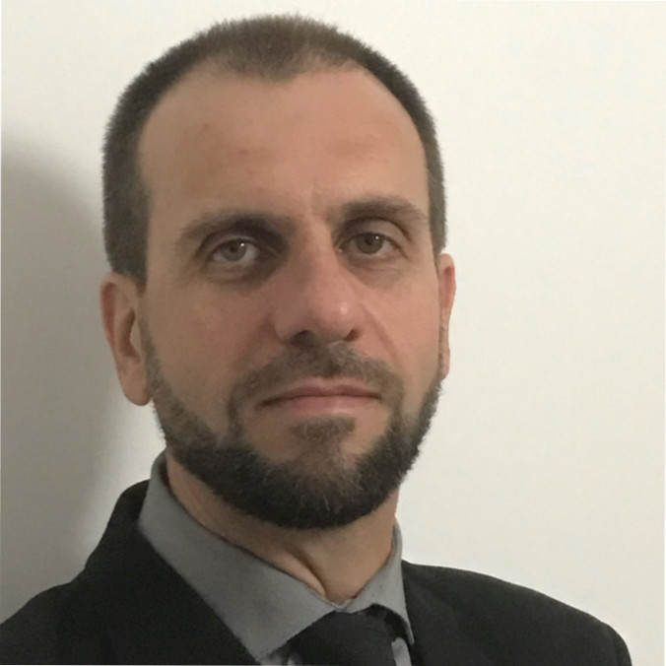





TEAM MEMBERS
Introduction
VP of Digital Products
Vitor Cruz
Director of Customer Service Products
Kumar Jaladanki
Director of Networks and Corporate Applications
Carlos Garbin
Director of IT Product Management
Heather Lajoie
Executive Manager | E&U
David Zorrilla Sanchez
NTTDATA US
Head of Talent & Organizational Transformation
Ana Sancha NTTDATA US
Delivery Lead
Gustavo Castellano NTTDATA US
Consulting Manager
Alfredo Soto
NTTDATA US

Slide 3
CONTEXT AND SESSSION OBJECTIVES
Introduction
PROJECT CONTEXT
OBJECTIVES FOR TODAY
Digital Products is facing rapid growth while lacking a defined end-to-end operating model, resulting in:
Operational fragmentation
Reactive decision-making without standardized value criteria
A disconnected tool ecosystem where intake, execution, and reporting are not integrated.
This leads to limited portfolio visibility, inefficient resource allocation, and an inability to trace business value from request to delivery.
To address these challenges, a focused 14-week transformation program is proposed to design and implement a unified, value-driven operating model, including:
All validated through a real pilot execution that will eventually set the stage for a scalable expansion.
Review the workplan: Align on the overall approach and confirm the sessions required during the first two weeks of the project to ensure effective execution of the discovery and baseline phase.
Validate the RFI: Review and align on the documentation and information required from Avangrid to successfully initiate the project and support the current state assessment.
Identify reusable assets: Align on which deliverables and artifacts from previous initiatives can be leveraged to accelerate progress and avoid duplication of effort.
Standardized
Product Lifecycle
Integrated tool ecosystem
Prioritization framework

Slide 4
index
1. PROJECT PLAN AND KEY NEXT STEPS
2. REQUEST FOR INFORMATION

Slide 5





Project Timeline & Key Deliverables
1. Project Plan & Key Next Steps
Apr 13
Apr 20
Apr 27
May 4
G1
May 11
May 18
May 25
Jun 1
Jun 8
Jun 15
Jun 22
Jun 29
Jul 6
Jul 13
G2
G3
G4
Pilot Readiness
Mid-Pilot Check
Adjustments Done
Decision
Step 1
Review & Baseline
Step 2
Define Lifecycle
Step 3
Design Tool Ecosystem
Step 4
Pilot Execution (BRS)
Key Deliverables
Step 5
Learn & Adjust
Review & baseline
Baseline report
Demand map
Project portfolio landscape
Define Lifecyle
Lifecycle map v1.0
Demand typology framework
Prioritization framework
Roles & RACI matrix
Design Tool Ecosystem
Tool ecosystem design
Jira configuration v1.0
Portfolio concept blueprint
Pilot Execution
Pilot execution report
First reporting output
Structured feedback log
Learn & Adjust
Lifecycle map v2.0
Jira configuration v2.0
Value criteria framework v2.0
Ways of Working playbook
Lessons learned document
Notes:
Focus on mapping the lifecycel for BRS

Slide 6
Initial Discovery Sessions
1. Project Plan & Key Next Steps
Week 1
Day 1 – April 13th | Day 2 | Day 3 | Day 4 | Day 5
PROPOSAL
Review reusable deliverables and tools
Discuss and align which previous deliverables can be leveraged to accelerate project activities
Stakeholders interviews
Leadership: Understand strategic priorities and expectations
Operation: Understand day-to-day execution, pain points, challenges and bottlenecks
Project Kickoff Meeting
Align scope, objective, timelines, roles and ways of working
Demand sources mapping
Identify all entry points, value stream flow, etc..
Week 2
Day 1 | Day 2 | Day 3 | Day 4 | Day 5
PROPOSAL
Portfolio review session
Build a full view of active initiatives and scope, including demand typology and prioritization
Capacity & resource model review
Understand team allocations and constraints
Tool ecosystem Review
Map tools and fragmentation across lifecycle
Reporting and metrics review
Understand current reporting, KPIS & gaps
Baseline validation workshop
Validate findings, confirm gaps and align on baseline

Slide 7
Initial Discovery Sessions
1. Project Plan & Key Next Steps
Session | Purpose | Participants | Description
1. Project Kickoff Meeting | Align on project scope, objectives, timeline, roles, and ways of working | Executive Sponsor, Product Owners, PMO, Management, BRS | Number of sessions: 1 Duration: 60–90 minutes
2. Reusable Deliverables & Tools Review | Identify and align on existing deliverables, frameworks, and tools that can be leveraged to accelerate the project | Executive Sponsor, Product Owner, | Number of sessions: 1 Duration: 60–90 minutes
3. Stakeholders interviews | Understand strategic priorities, operational challenges, and current pain points | Executive Sponsor, Product Owner, PMO | Number of sessions: 6–10 (depending on stakeholder availability) Duration: 45–60 minutes each
4. Demand sources mapping | Identify and map all demand entry points, channels, and current intake flows | Product Owner, PMO, BRS Liason, demand sources representatives | Number of sessions: 1–2 Duration: 90–120 minutes
5. Portfolio review session | Build a comprehensive view of active initiatives, scope, and prioritization | Product Owner, PMO | Number of sessions: 1-2 Duration: 90–120 minutes
6. Tool ecosystem Review | Assess current tools and identify fragmentation across the lifecycle | Product Owner, PMO | Number of sessions: 1–2 Duration: 90–120 minutes
7. Capacity & Resource Model Review | Understand team structure, allocation model, and delivery constraints | Executive Sponsor, Product Owner, PMO | Number of sessions: 1 Duration: 60–90 minutes
8. Reporting & Metrics Review | Understand current reporting practices, KPIs, and visibility gaps | Product Owner, PMO | Number of sessions: 1 Duration: 60–90 minutes
9. Baseline Validation Workshop | Validate findings, confirm key gaps, and align on current state baseline | Executive Sponsor, Product Owners, PMO, Management, BRS | Number of sessions: 1 Duration: 90–120 minutes

Slide 8
Champion selection
1. Project Plan & Key Next Steps
PRODUCT MANAGEMENT CHAMPION
Ensures alignment at the portfolio level, connecting initiatives to strategic priorities, managing cross-team dependencies, and providing governance and visibility across the program.
SAP CHAMPION
Acts as the primary representative of SAP delivery, ensuring alignment between business demand, functional scope, and SAP execution capabilities. This role provides visibility into SAP constraints, dependencies, and delivery implications across the lifecycle.
DIGITAL APPLICATIONS CHAMPION
Acts as the primary representative of Digital Applications, ensuring alignment between business demand, functional scope, and execution capabilities. This role provides visibility into constraints, dependencies, and delivery implications across the lifecycle.
BRS PILOT CHAMPION
Represents the business side and owns the demand from intake to validation. Ensures that requests are clearly defined, aligned with business value, and actively participates in prioritization and pilot execution.
🎯 CHAMPION RESPONSIBILITIES
Act as the single point of contact for their respective area
Ensure end-to-end visibility of demand from intake to delivery
Ensure demand is clearly defined, structured, and aligned with business needs
Validate feasibility and identify constraints, dependencies, and integration impacts
Support prioritization decisions based on business value and strategic alignment
Ensure backlog quality, readiness, and proper structuring of work items
Coordinate across teams to ensure alignment and smooth handoffs
Monitor execution progress and provide visibility on status and risks
Identify and escalate bottlenecks, risks, and cross-team dependencies
Ensure data accuracy and traceability across tools and reporting
Validate delivered outcomes against business expectations and value
Provide continuous feedback during pilot execution and improvement cycles
Support governance processes and decision-making forums
Drive adoption of the defined ways of working and lifecycle model

Slide 9
index
1. PROJECT PLAN AND KEY NEXT STEPS
2. REQUEST FOR INFORMATION

Slide 10
Project Timeline & Key Deliverables
2. Request for Information
1. Organizational & Governance
3. Portfolio & Project Data
5. Performance & Reporting
Current and Future Digital Products Org Chart [send existing]
Current and Future Roles & Responsibilities documentation [send existing]
BRS structure and liaison model [send existing]
PMO involvement model with CX & Digital COE / BRs [send existing]
Current governance forums (steering committees, cadence, attendees) [Template 1]
Decision-making process (who approves what) [Interview]
Full list of active projects (SAP + others): Name, Sponsor, Start / End date, Status, Assigned team, Budget (if available) [Template 4] or [send existing]
PDD documentation [send existing]
Roadmap documents [send existing]
Project typology (if exists: small/medium/large) [Interview] [To-be deliverable]
Portfolio prioritization logic (if exists) [send existing]
Historical delivery performance (planned vs actual) [Interview] [To-be deliverable]
Reporting templates used for leadership and SLA definitions [send existing]
KPIs currently tracked (delivery, value, efficiency) [send existing]
Examples of dashboards [send existing]
Frequency of reporting (weekly, monthly, quarterly) [send existing]
Pain points in reporting [Interview] [To-be deliverable]
6. Pilot Preparation
Candidate projects for pilot (3 options)
Identified BRS lead / OPCO
Availability confirmation (Weeks 7–12)
      [all list - Template 6]
2. Demand & Intake
4. Capacity & Resource Model
All current demand entry channels (ServiceNow queues, Email inboxes, Forms , Kanban boards) [Template 2]
Volume of demand (last 12 months): [Template 3]
    Requests per month
    By department
    By typology (if exists)
Existing intake real forms or templates [send existing]
Current prioritization criteria (formal or informal) [send existing]
Examples of recent requests (5–10 samples end-to-end) [send existing]
Dedicated vs shared resources
Allocation model
Team capacity per sprint / month
Resource constraints / bottlenecks
Vendor involvement and structure
[all list - Template 5]
7. Value & Prioritization
Any existing prioritization models [send existing]
Business case templates (if any) [send existing]
ROI calculation methods (if any) [send existing]
Examples of past prioritization decisions [send existing]
Strategic priorities (2025–2026) [send existing]
OKRs or business KPIs measure [send existing]

Slide 11
2. Request for Information
RFI Template Mapping
TEMPLATE PROVIDED
NO TEMPLATE NEEDED — Send existing documents (Main ones)
Template 1 — Governance & Forums Map - Slide 12
Digital Products Org Chart — Send existing (PPT, PDF)
Roles & Responsibilities — Send existing documentation
Template 2 — Demand Entry Channels Map - Slide 13
BRS structure & liaison model — Send existing documentation
Template 3 — Demand Volume Tracker - Slide 14
PMO involvement model — Narrative description
Template 4 — Project Portfolio Inventory - Slide 15
Intake forms / templates — Send existing forms
Roadmaps — Send current files
Template 5 — Resource & Capacity Overview - Slide 16
Reporting templates & dashboards — Send examples / screenshots
Template 6 — Pilot Candidate Assessment - Slide 17
KPIs currently tracked — Send existing framework
Strategic priorities & OKRs 2025–2026 — Send existing docs
2. Request for Information
RFI Template Mapping

Slide 12
2. Request for Information
Template 1 — Governance & Forums Map
Please list all governance forums, steering committees, and recurring meetings related to Digital Products / SAP CoE.
Forum Name | Cadence | Key Participants | Decision Scope | Artifacts Produced | Status
e.g. SAP Steering Committee | Monthly | CIO, VP Digital, BRS Leads | Budget approval, project prioritization | Meeting minutes, action log | Active
Cadence: Weekly | Bi-weekly | Monthly | Quarterly | Ad-hoc
Status: Active | Inactive | Proposed

Slide 13
2. Request for Information
Template 2 — Demand Entry Channels Map
Please list all channels through which demand currently enters the Digital Products / SAP CoE team.
Channel Name | Tool / Platform | Who Submits | Approx. Volume/Month | SLA (if exists) | Triage Process | Approval Flow
e.g. ServiceNow Queue | ServiceNow | BRS Leads, End Users | ~40 | 48h first response | Auto-assigned to queue manager | Manager > Product Owner
Include all formal AND informal channels.

Slide 14
2. Request for Information
Template 3 — Demand Volume Tracker
Please provide demand volume data for the last 12 months. One row per month, broken down by department and request type.
Month | # Requests | Department | Request Type | Entry Channel | Status (Final) | Avg. Resolution (days)
e.g. Jan 2024 | 35 | BRS | Enhancement | ServiceNow | Completed | 15
Entry Channel options: ServiceNow | Email | Jira | Kanban | Teams | Phone | Other
Request Type: Enhancement | Bug Fix | New Feature | Maintenance | Ad-hoc | Regulatory

Slide 15
Template 4 — Project Portfolio Inventory
2. Request for Information
Please complete one row per active project (SAP and non-SAP). Add rows as needed.
Project Name | Sponsor | Start Date | End Date | Status | Assigned Team | Budget (if avail.) | Priority
e.g. SAP S/4 Migration | Sponsor | 2024-01-15 | 2025-06-30 | In Progress | SAP Core Team | $500K | High
Status options: Not Started | In Progress | On Hold | Completed | Cancelled
Priority: High | Medium | Low

Slide 16
2. Request for Information
Template 5 — Resource & Capacity Overview
Please list all teams/squads involved in Digital Products delivery. One row per team or resource group.
Team / Squad | # People | Dedicated / Shared | Key Skills | Allocation % | Vendor? | Monthly Capacity (hrs) | Bottlenecks
e.g. SAP ABAP Team | 6 | Dedicated | ABAP, Fiori, S/4 | 100% | NTT Data | 960 | Limited Fiori expertise
Dedicated / Shared: Dedicated (100% to Digital Products) | Shared (% split — specify)
Vendor: Internal | Vendor Name (e.g. Accenture, Deloitte, Infosys)

Slide 17
2. Request for Information
Template 6 — Pilot Candidate Assessment
Please propose 3 candidate projects for the pilot phase (Weeks 7-12). Complete one column per candidate.
Assessment Criteria | Candidate 1 | Candidate 2 | Candidate 3
Project Name
BRS Lead / OPCO
Current Phase
Timeline fit (Weeks 7-12)
Complexity (Low/Med/High)
# Resources involved
Key Dependencies
Visibility / Strategic value
Success Criteria
Availability confirmed?

Slide 18













Demand Sources (AS-IS): How Work Reaches Digital Products Today
Demand enters through multiple departments and channels without a single intake point or structured filtering. This leads to mixed priorities, inefficiencies, and reactive execution with no clear value traceability.
DEMAND SOURCES
DIGITAL PRODUCTS
CURRENT PAIN POINTS
Illustrative & Non-exhaustive
BRS
SAP
Customer Services
Requests can be submitted to BRS through ticketing system and Kanban is used to manage requests
Multiple Entry Points
CX & DIGITAL
Large Demand is planned and organized annually through PDD Process
INFRASTRUCTURE
No single front door. Requests arrive via fragmented, unmonitored channels.
DATA & ANALYTICS
AI
No Filtering
OT
Low-value and strategic demands are mixed without initial triage.
PROCUREMENT
REGULATORY
CORPORATE
ELECTRIC, GAS OPS & CORP
P&T
GIS
Pilot Scope
Note: Ideation & Strategy occur upstream (Business Side). The Digital Products lifecycle begins formally at Intake.
Service Now
Forms
Teams
Kanban
Email
Meetings
IT demand sources
Notes:
Heather = Ken
WoW se ha trabajado en Cx & Digital CoE. (ramón→ Javi). Diseño de solución de customer. Websites/mobile, etc
Midiendo nps de customer.
2. P&T Process & Technology: Aplicaciones para field operators. Como se roganziacion, proeyctos en JIRA, portfolio, gestion de operación, skill, roles. Tocamos dimensiones para mejorar y eficientar modelo. Se ha hecho lo mismo. Diagnostico-> equipo estbale en la implementación. Ahora está en implementación.
Otro Proyecto en Renovables: con CoE de IT (WoW).
Nueva estrcutura de Digital products integrando SAP y APP. Aplications tiene mayor curva por el proeycto de P&T. con Sap no habia tenido un link con el proeycto de CX. En Sap no conocemos. Con Applications, ya lo temenos mapeado. Pendiente saber como trabajan con otras áreas. Ahroa solo es la definición. Hacer el blueprint del proceso y de los roles. Definir y reutilizar al maximo lo ya definido. Centralziar y decidir sobre la gestion de demanda. Buscar estandarizar definición. Marcar GAPs en el proceso, pedir información suficiente para priorizar.
La priorización es P&T en conjunto con aplicaciones. Big Room planning, todos los equipos y trabajan los objetivos del Q. que si es necesario levanter con Fuentes de la demanda.
Lo mas importante para Victor→ poner orden en el departametno. Y ver qué pedirles, como tienen interlocuiones, conversaciones, etc… Si mapear cómo entra la demanda, volume tipo de info, y ver GAPs. Establecer igual proceso en Digital Products.
El foco es la base; poder ver cuantos proeyctos, progreso, riesgos, impactos.
}3: Ahora digital Products
Esos dos son los más grandes.

Slide 19
index
1. PROJECT PLAN AND KEY NEXT STEPS
2. REQUEST FOR INFORMATION
3. REUSABLE ASSETS

Slide 20
Project Timeline & Key Deliverables
2. Request for Information
1. Organizational & Governance
3. Portfolio & Project Data
6. Performance & Reporting
Current Digital Products Org Chart [send existing]
Roles & Responsibilities documentation [send existing]
  Existing RACI matrices (if available) [Interview]
List of Product Owners, Product Managers, Tech Leads (if they give us the org chart)
BRS structure and liaison model [send existing]
PMO involvement model with CX & Digital COE / BRs [send existing]
Current governance forums (steering committees, cadence, attendees) [Template 1]
Decision-making process (who approves what) [Interview]
Full list of active projects (SAP + others): Name, Sponsor, Start / End date, Status, Assigned team, Budget (if available) [Template 4]
PDD documentation //we already have
Roadmap documents
Project typology (if exists: small/medium/large)[Interview] [To-be deliverable]
Dependencies between projects
Portfolio prioritization logic (if exists) [send existing]
Historical delivery performance (planned vs actual) [Interview - RFI] [send existing]
Reporting templates used for leadership and SLA definitions [send existing]
KPIs currently tracked (delivery, value, efficiency) [send existing]
Examples of dashboards [send existing]
Frequency of reporting (weekly, monthly, quarterly) [send existing]
Pain points in reporting [Interview]
7. Pilot Preparation
Candidate projects for pilot (3 options) [Template 6]
Identified BRS lead / OPCO [Template 6]
Availability confirmation (Weeks 7–12) [Template 6]
Dependencies and risks
Business owner commitment
Measurable success criteria
2. Demand & Intake
4. Tools & Systems
All current demand entry channels (ServiceNow queues, Email inboxes, Forms , Kanban boards) [Template 2]
Exhaustive map of entry points
Volume of demand (last 12 months): [Template 3]
    Requests per month
    By department
    By typology (if exists)
Existing intake forms or templates [send existing]
Current prioritization criteria (formal or informal) [send existing]
Examples of recent requests (5–10 samples end-to-end) [send existing]
SLA for intake / triage (if exists) [Interview] [To-be deliverable]
Rejection / filtering criteria (if any) [Interview] [To-be deliverable]
Jira: Access to Jira instance, Workflow configurations, Issue types, Boards, Fields, Reporting dashboards.
ServiceNow: Request types, Approval flows, SLA metrics
PPMNow: (or equivalent): Current usage model, Data structure, Reporting outputs
8. Value & Prioritization
Any existing prioritization models [send existing]
Business case templates (if any) [send existing]
ROI calculation methods (if any) [send existing]
Examples of past prioritization decisions [send existing]
Strategic priorities (2025–2026) [send existing]
OKRs or business KPIs measure [send existing]
5. Capacity & Resource Model
Team structure
Dedicated vs shared resources [Template 5]
Allocation model [Template 5]
Team capacity per sprint / month [Template 5]
Resource constraints / bottlenecks [Template 5]
Vendor involvement and structure [Template 5]
9. Knowledge base
Process documentation (if any) [Interview - RFI]
Guidelines [Interview - RFI]
Training materials
Confluence / SharePoint repositories [Interview - RFI]

Slide 21




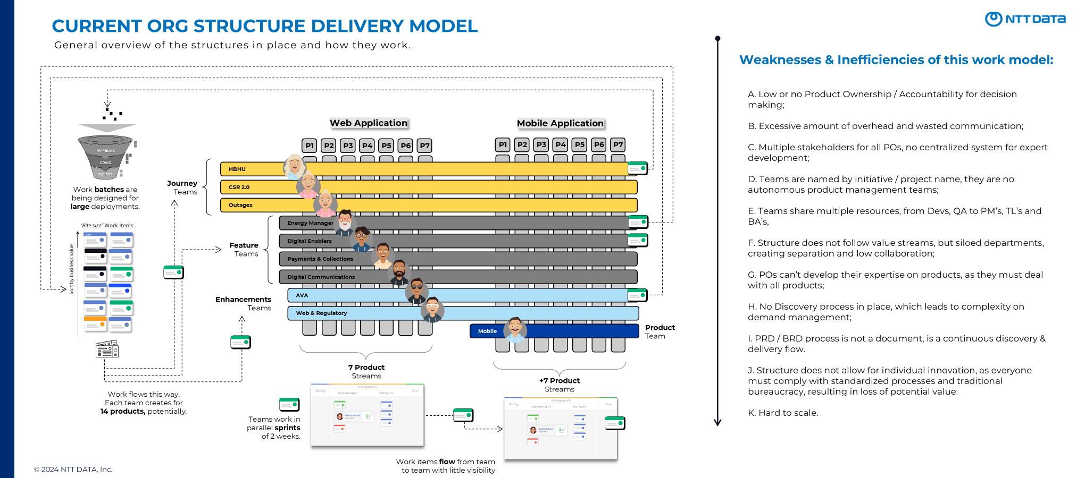
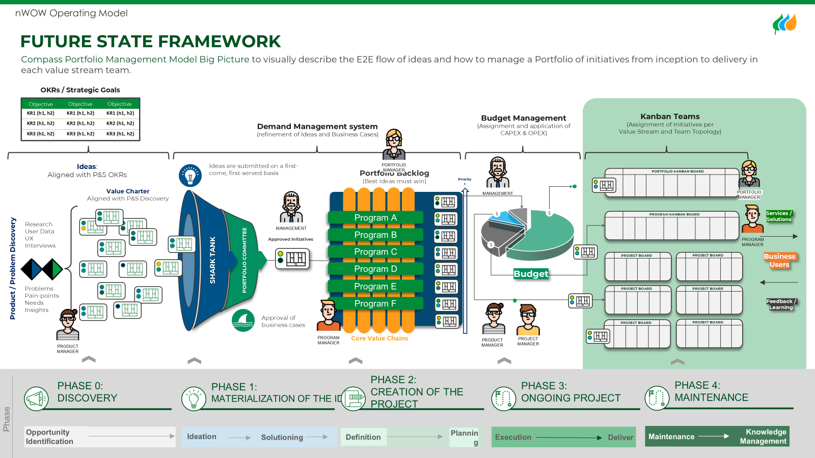
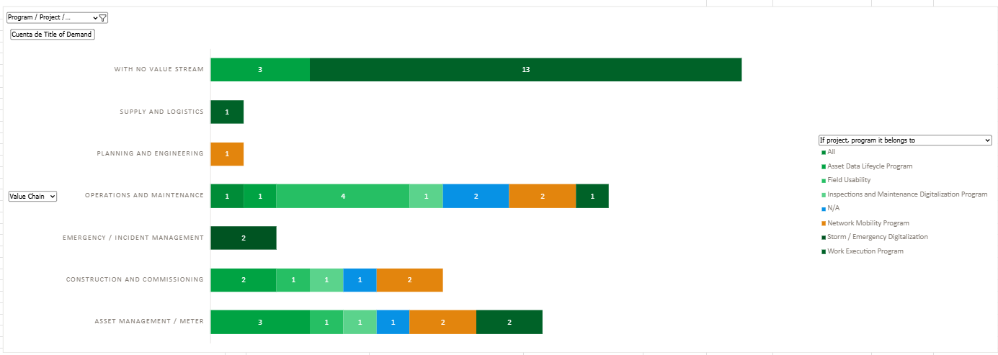
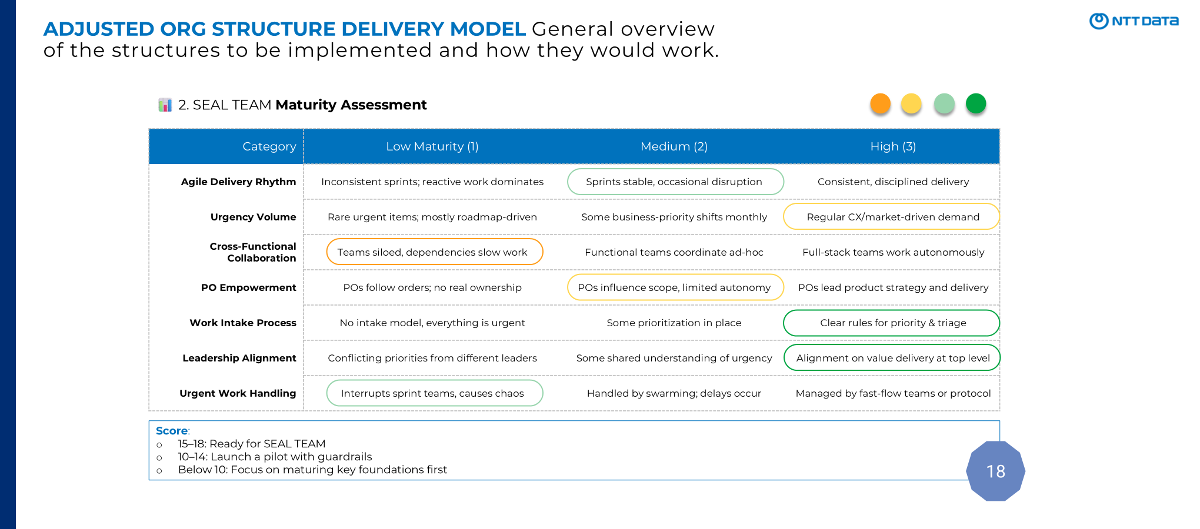
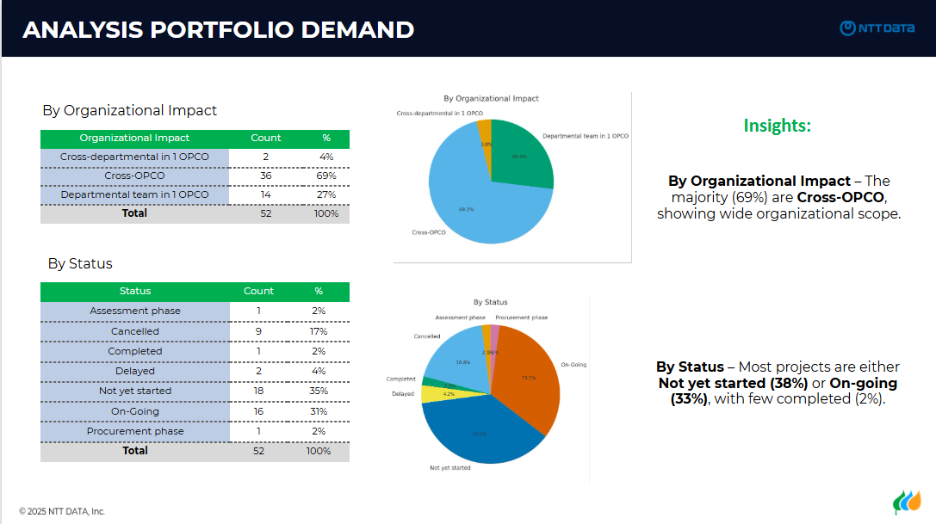
Key Deliverables – Review and Baseline
3. Reusable Assets
Baseline Report
Current state diagnosis & gap analysis
Demand Map
Visualizing sources & channels
Project Portfolio Landscape
Full inventory with typology & milestones
Analysis nWOW - Structure and Portfolio_2
NTTDATA-Digital Strategy - NextGen Produc Ops Org Design SEAL-SIX Model v.1.7 06.29
nWOW - New Ways of Working - P&S Lean Operating Model 03.10.2026 v1.2
NTTDATA-Digital Strategy - NextGen Produc Ops Org Design SEAL-SIX Model v.1.7 06.29
NextGen Assessment - Demand Management Deliverables - Avangrid 07.22.2025 v.1.0

Slide 22




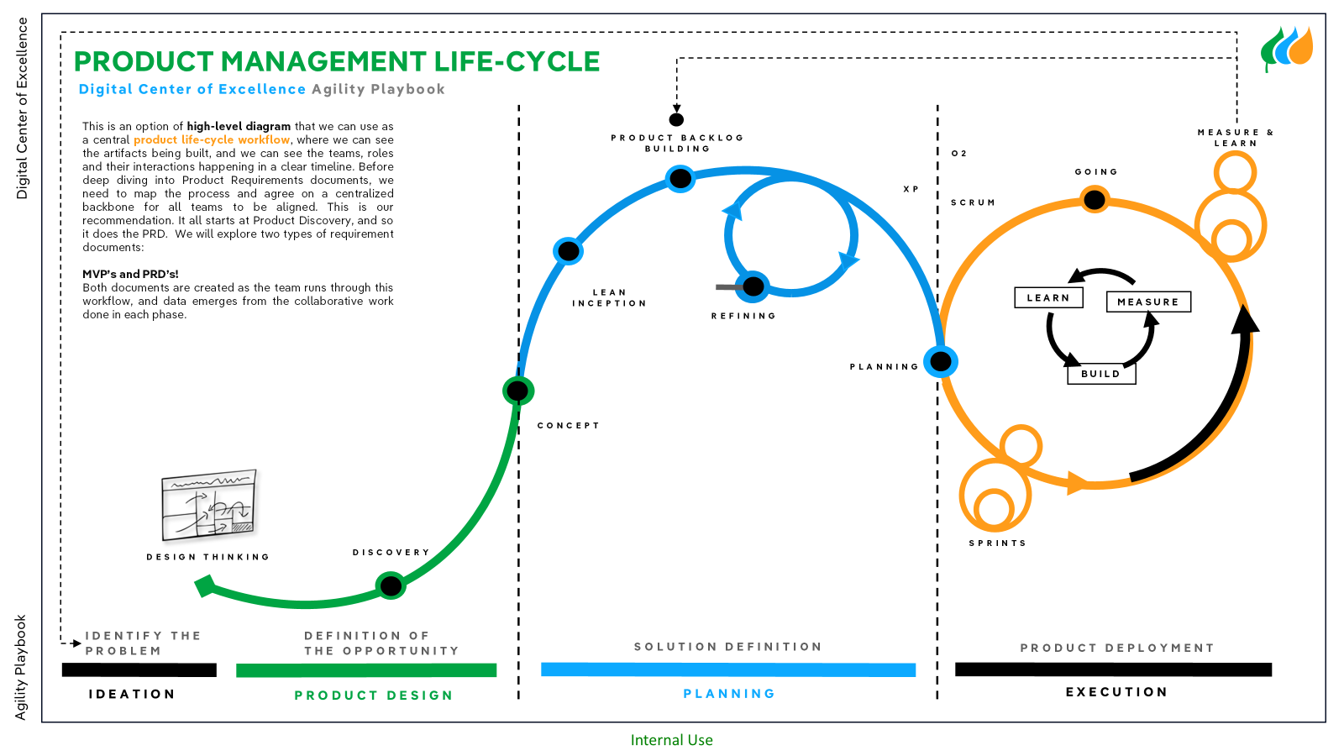
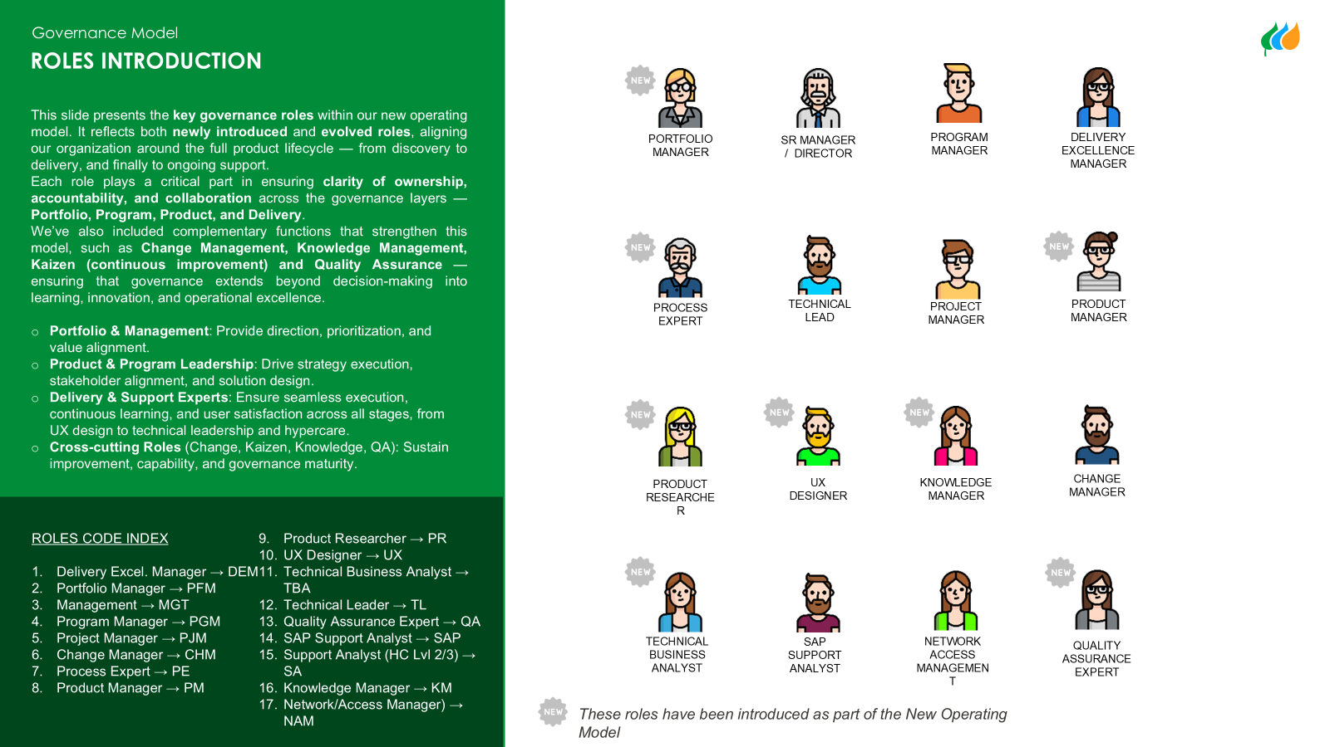
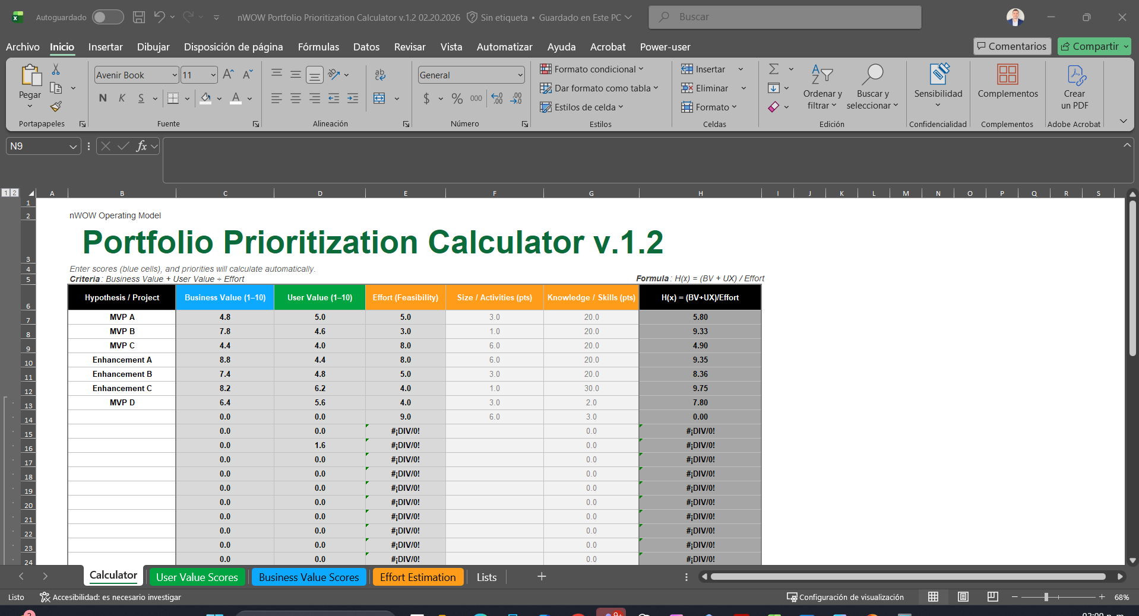
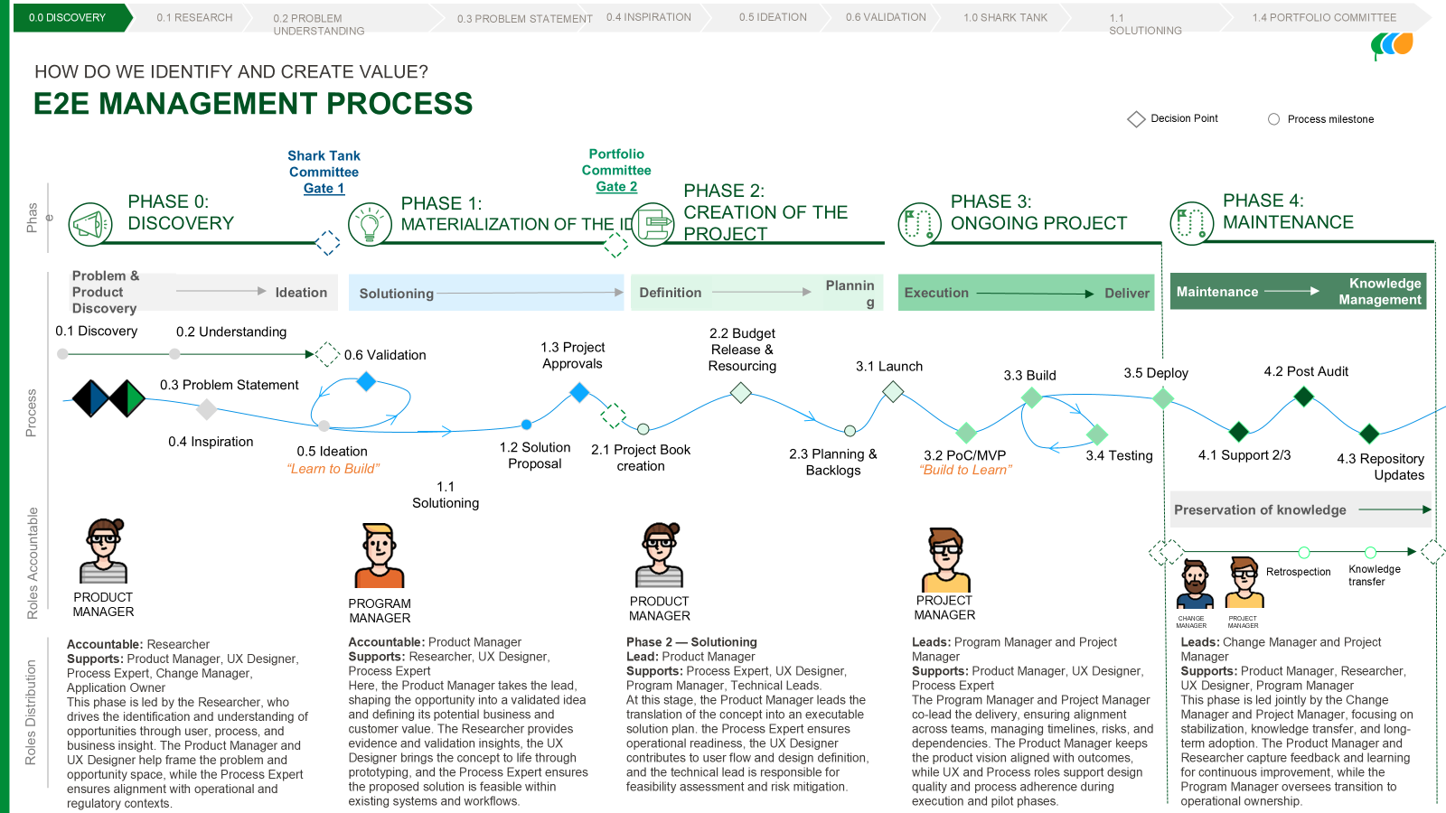
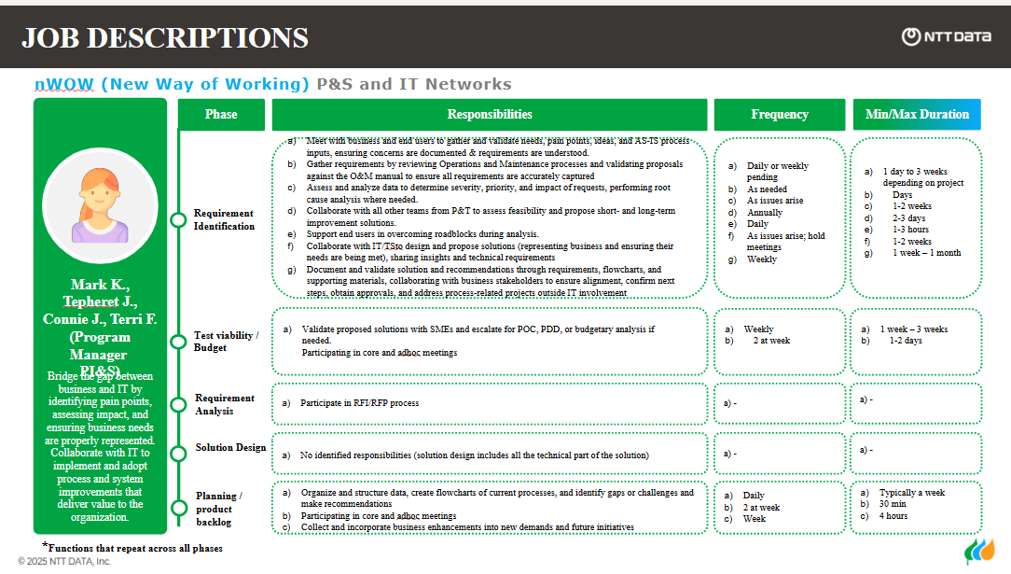
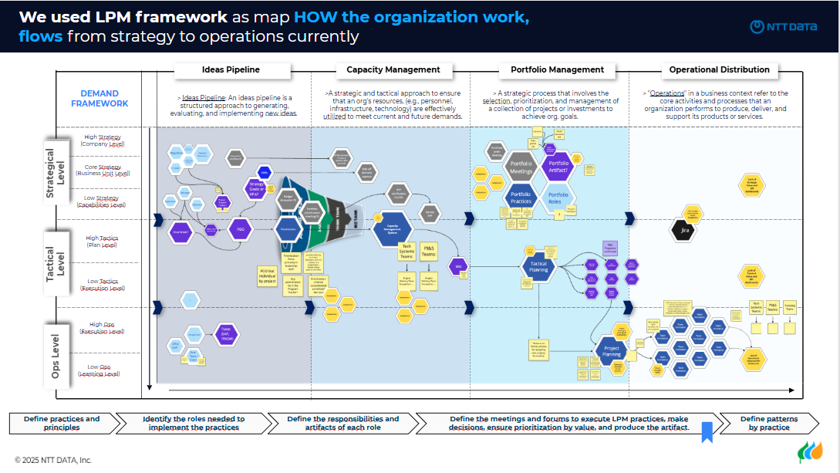
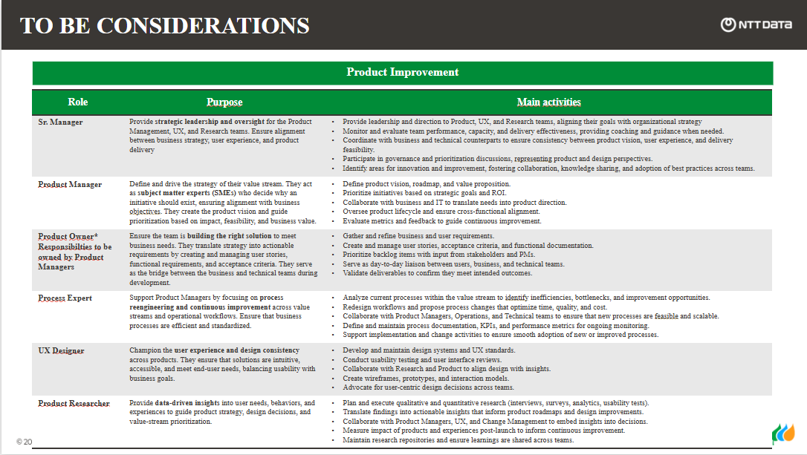
Key Deliverables – Define Product Lifecycle
3. Reusable Assets
Lifecycle Map v1.0
End-to-end process diagram
Demand Typology
Classification framework
Prioritization Framework
Scoring logic & criteria v1.0
Roles & RACI Matrix
Responsibilities per phase
Analysis nWOW - Structure and Portfolio_2
nWOW Portfolio Prioritization Calculator v.1.2 02.20.2026
nWOW - New Ways of Working - P&S Lean Operating Model 03.10.2026 v1.2
[17] Agility Playbook - Digital Center of Excellence 06.18.2025 V.1.7
NextGen Assessment - Demand Management Deliverables - Avangrid 07.22.2025 v.1.0
nWOW - Roles and Responsibilities Deliverables - Avangrid 10.06.2025 v.1.1 Final

Slide 23



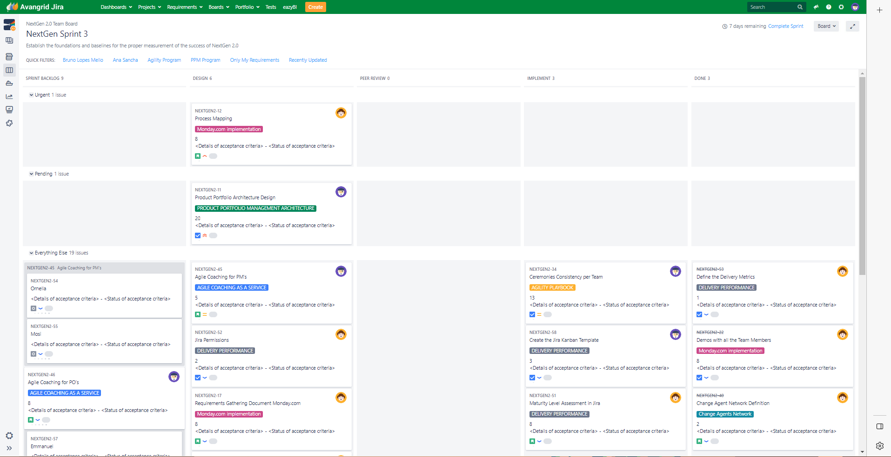
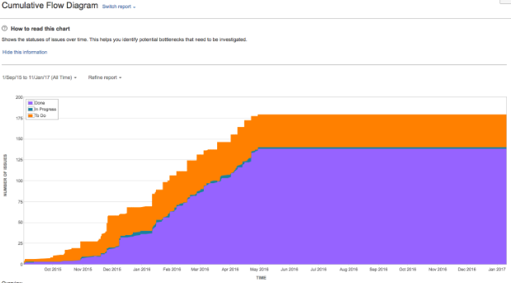
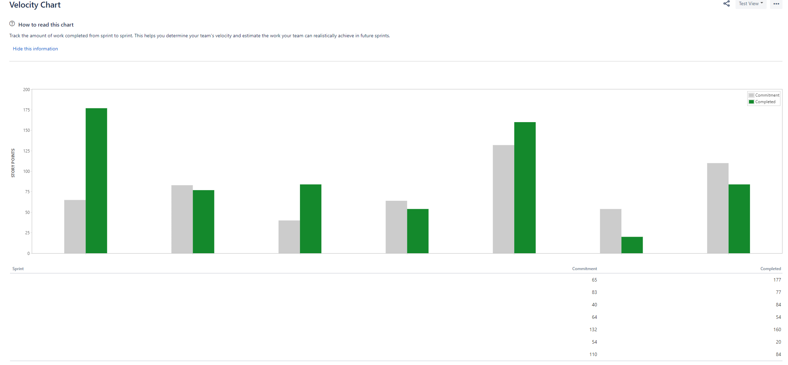
Key Deliverables – Design the Tool Ecosystem
3. Reusable Assets
Tool Ecosystem Design
Architecture map of integrated toolset
Jira Configuration v1.0
Pilot-ready environment (Boards, Workflows)
Portfolio Concept Blueprint
Documented management guidelines
[33] NextGen 2.0 - Jira Management User Guide for CX Digitall CoE 27.06.2024
[CX] JIRA Agile Management Playbook - Center of Excellence 25.03.2024 V.1.0

Slide 24



Key Deliverables – Pilot Execution
3. Reusable Assets
Pilot Execution Report
End-to-end validation of process effectiveness
First Reporting Output
Standardized status & metric report sample
Structured Feedback Log
Documented friction points & improvement areas

Slide 25



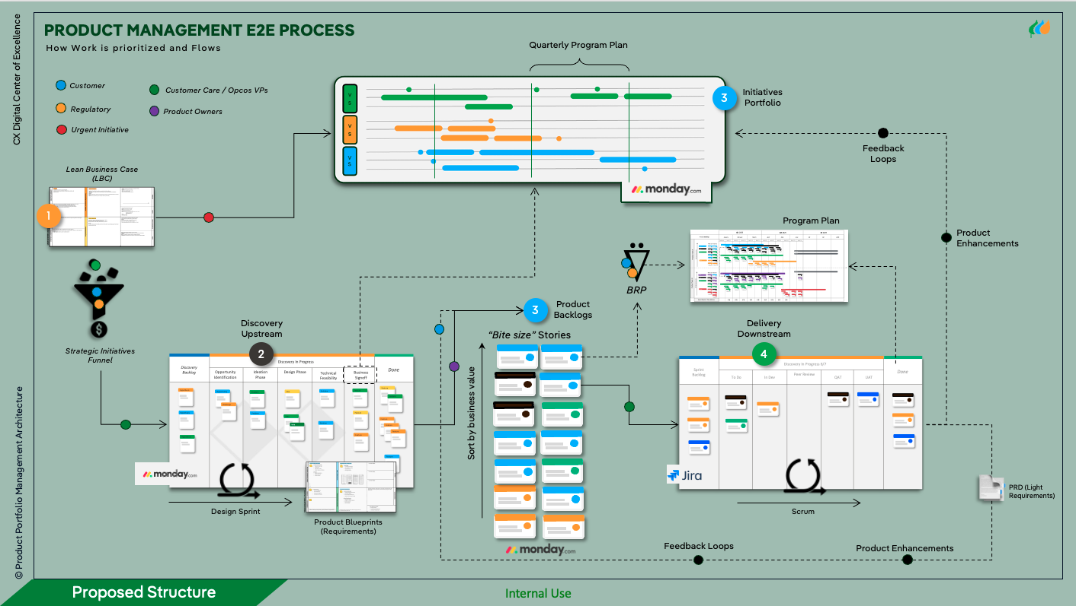
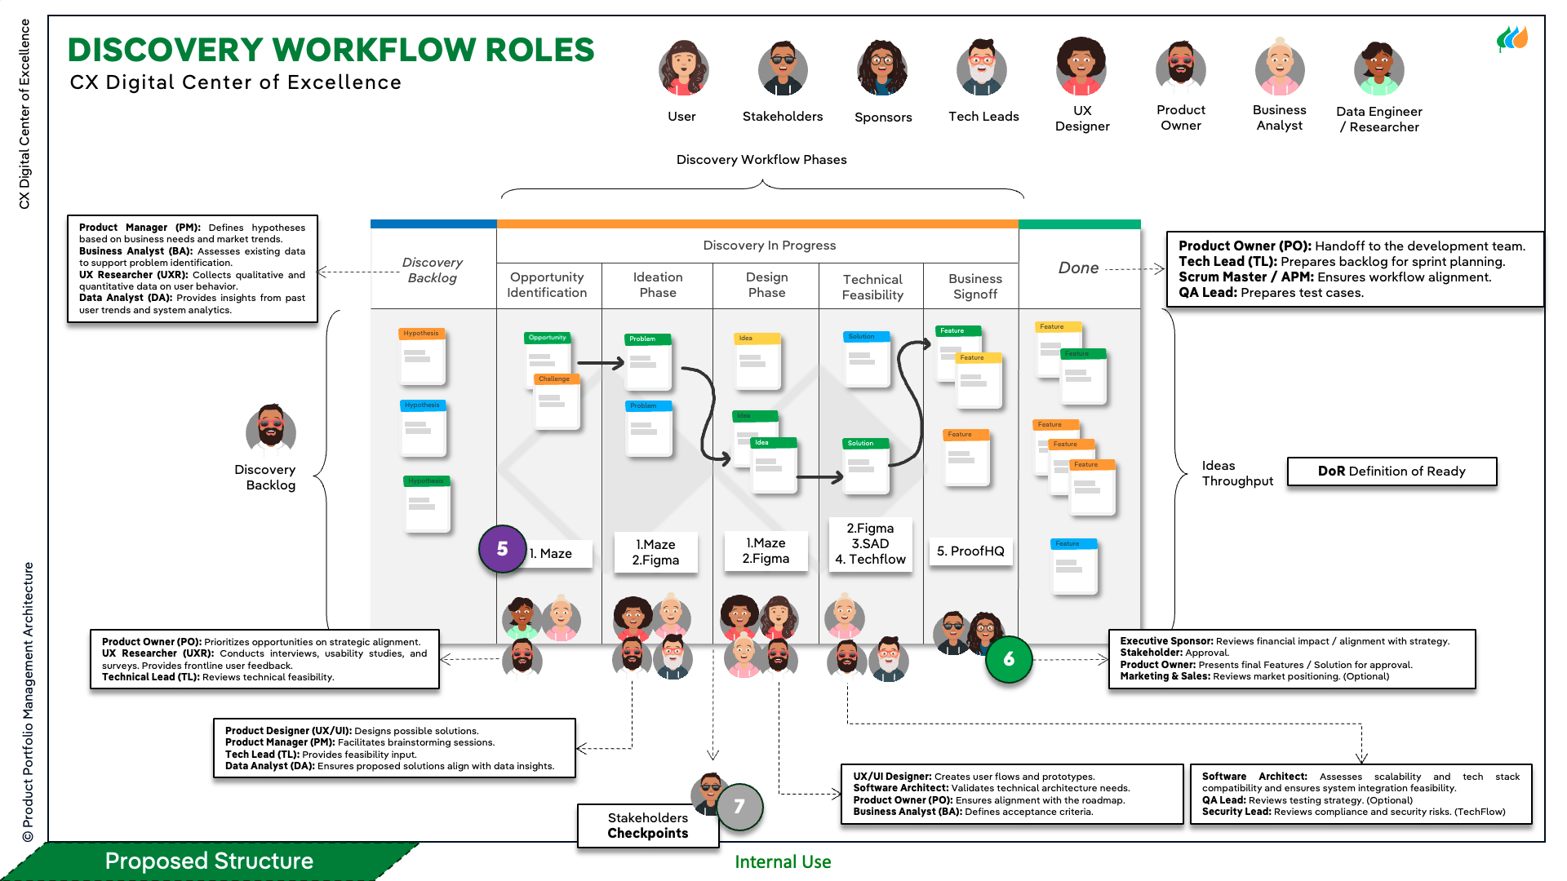
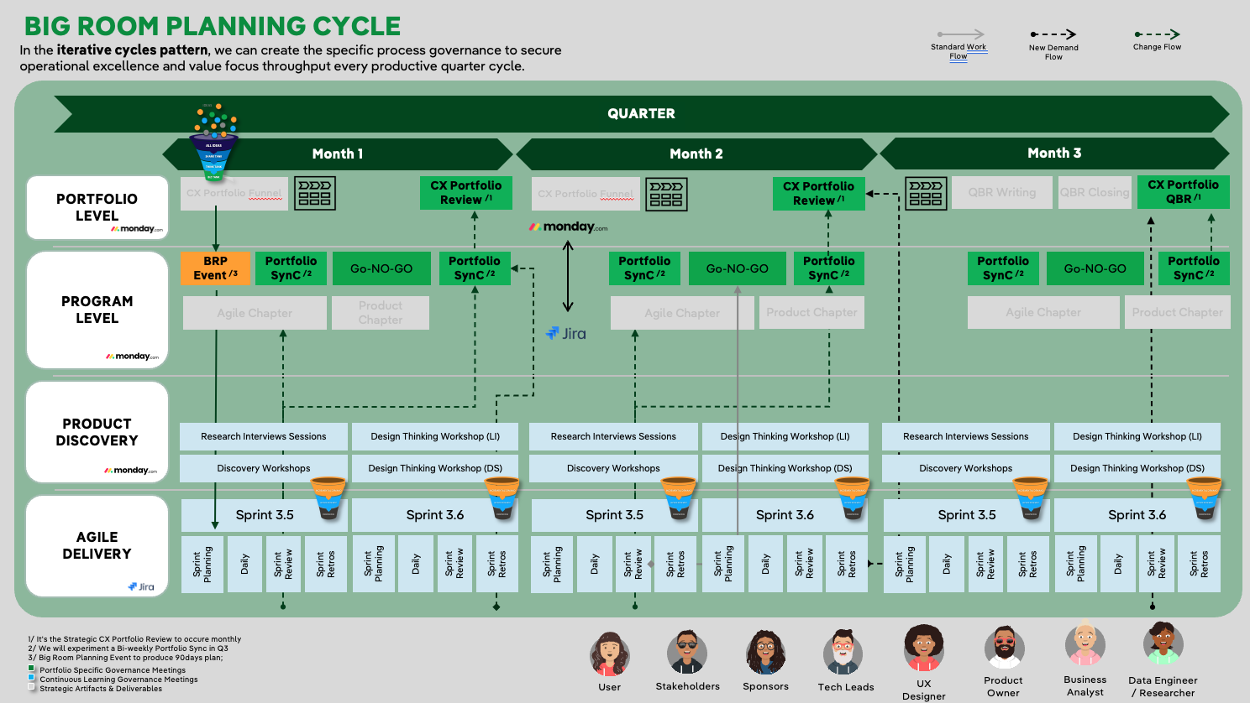
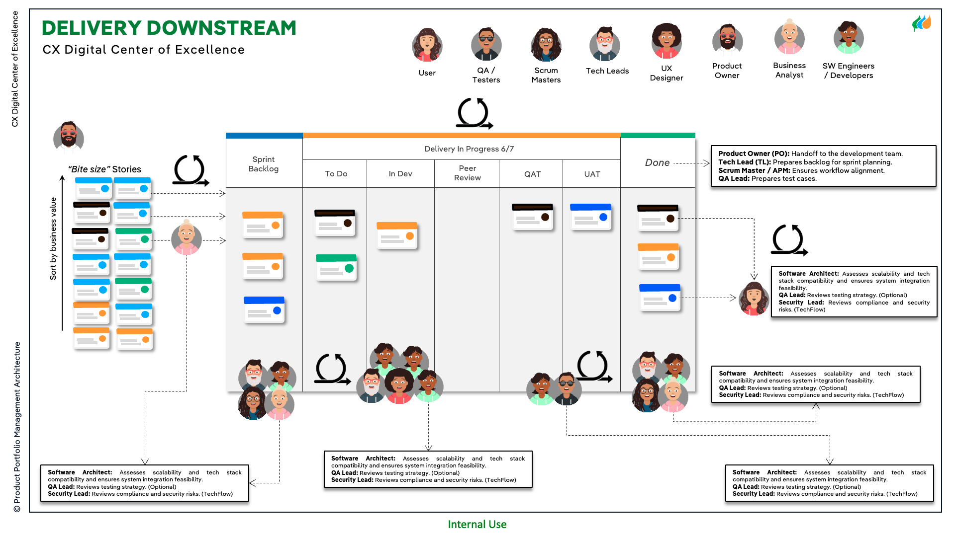
Key Deliverables – Learn & Adjust
3. Reusable Assets
Lifecycle Map v2.0
Optimized End-to-end process
Jira Config v2.0
Production-ready configuration
Value Criteria Framework v2.0
Calibrated scoring model
Ways of Working Playbook
Comprehensive process & tool guide
[17] Agility Playbook - Digital Center of Excellence 06.18.2025 V.1.7
nWOW Portfolio Prioritization Calculator v.1.2 02.20.2026
[33] NextGen 2.0 - Jira Management User Guide for CX Digitall CoE 27.06.2024
[CX] JIRA Agile Management Playbook - Center of Excellence 25.03.2024 V.1.0
[12] Digital CoE Operating Model - Playbook - 01.05.2026 V.2.5. FINAL pptx

Slide 26

Key Deliverables – Learn & Adjust
3. Reusable Assets
Lessons Learned Document
Insights for future waves

